Slide 1
Experiments - NIM-PET

Slide 2
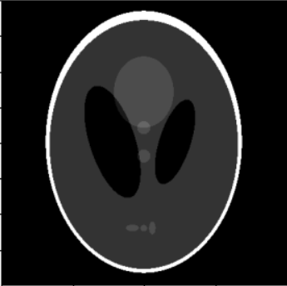
Experiment 1 - Image Reconstruction
Y
SIREN
X
Model input
Model output
Loss = MSE( Model output, Shepp-Logan Image)

Slide 3
Results
Optimizer | LR | Steps | MSE | PSNR
Adam | 1e-4 | 1000 | 9.87e-05 | 40.06
Adam | 1e-3 | 1000 | 1.83e-05 | 47.37
Adam | 1e-3 | 1500 | 3.94e-05 | 44.05
Adam | 1e-3 | 3000 | 4.33e-06 | 53.64

Slide 4
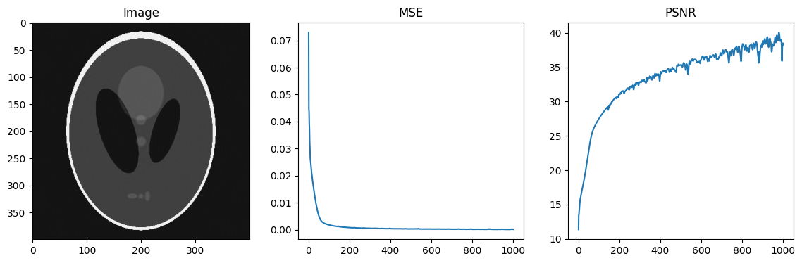
Adam : LR=1e-4 (1000 steps)

Slide 5
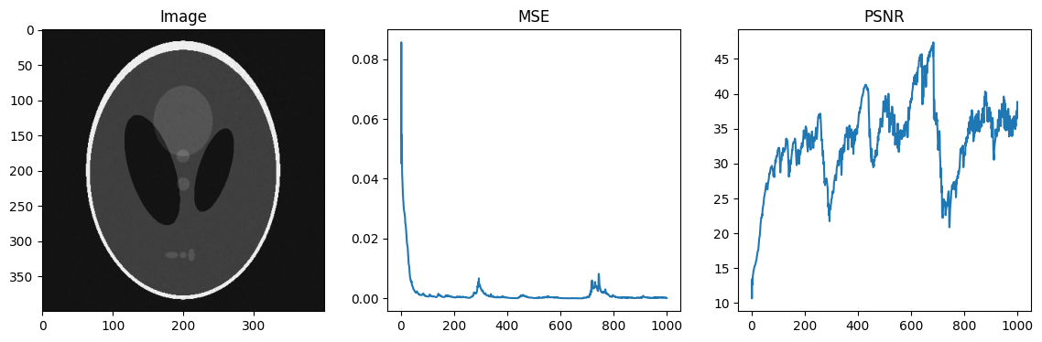
Adam : LR=1e-3 (1000 steps)

Slide 6
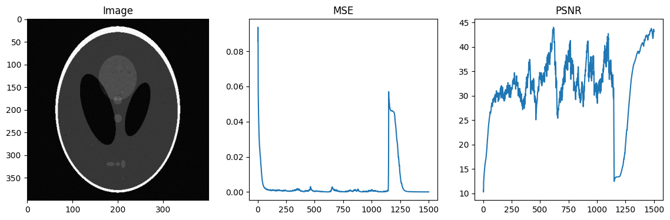
Adam : LR=1e-3 (1500 steps)

Slide 7
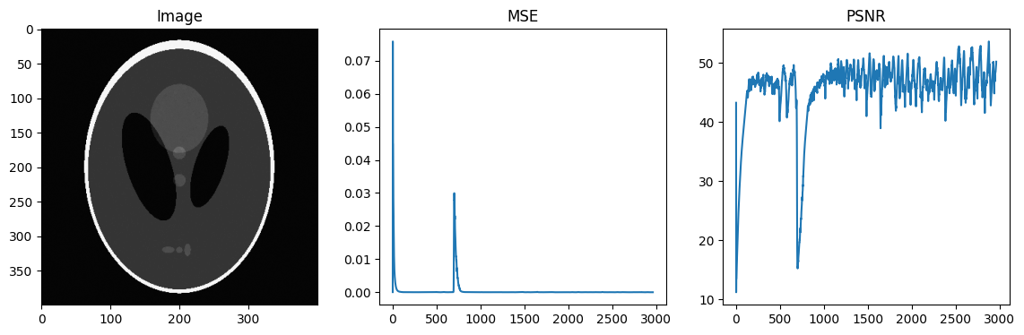
Adam : LR=1e-3 (3000 steps)

Slide 8
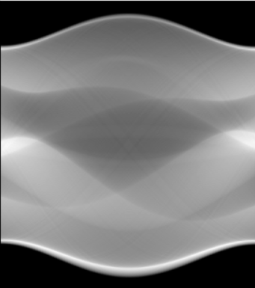
Experiment 2 - Sinogram Reconstruction
Y
SIREN
X
Model input
Model output
Loss = MSE( Model output, Shepp-Logan Sinogram)

Slide 9
Results
Optimizer | Angles | LR | Steps | MSE | PSNR
Adam | 180 | 1e-4 | 1500 | 728.89 | 11.90
Adam | 180 | 1e-3 | 1500 | 3.96 | 34.55
Adam | 100 | 1e-3 | 1500 | 64.60 | 28.37
Adagrad | 180 | 1e-3 | 1500 | 1516.94 | 8.72
Adagrad | 180 | 1e-2 | 3000 | 66.64 | 22.29

Slide 10
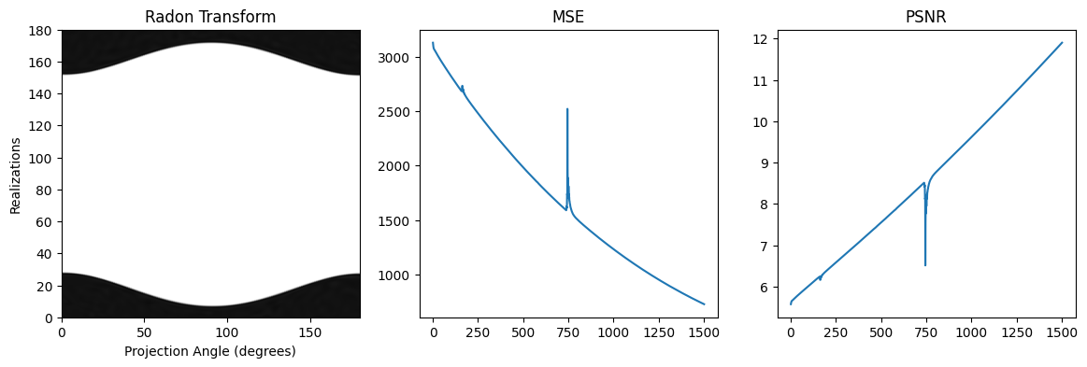
Adam : LR=1e-4 (1500 steps)

Slide 11
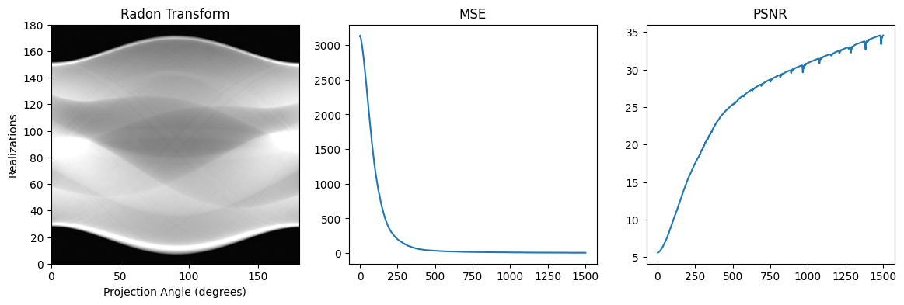
Adam : LR=1e-3 (1500 steps)

Slide 12
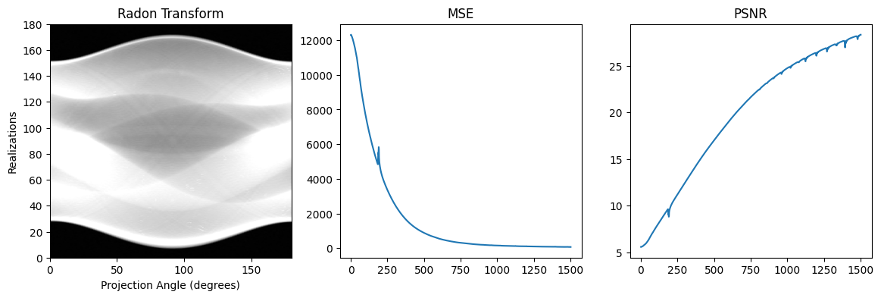
Adam : LR=1e-3 (1500 steps) - 100 Angles

Slide 13
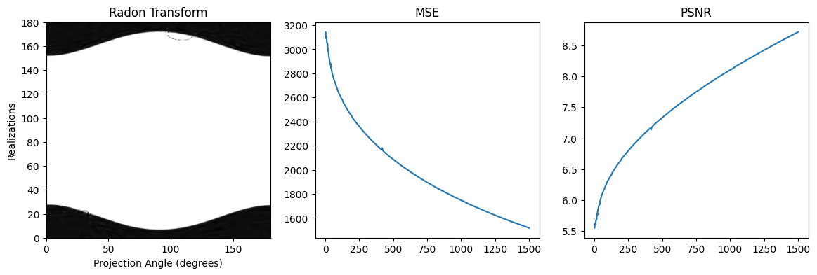
Adagrad : LR=1e-3 (1500 steps)

Slide 14
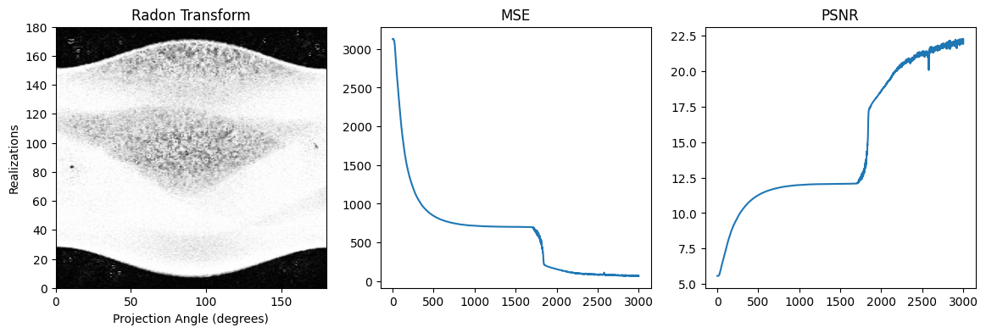
Adagrad : LR=1e-2 (3000 steps)

Slide 15
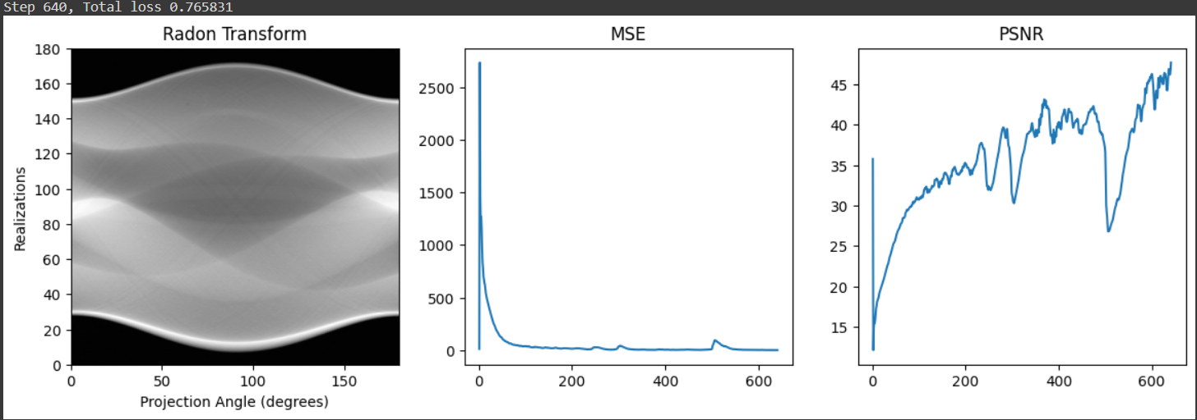
Adam : LR=1e-3

Slide 16
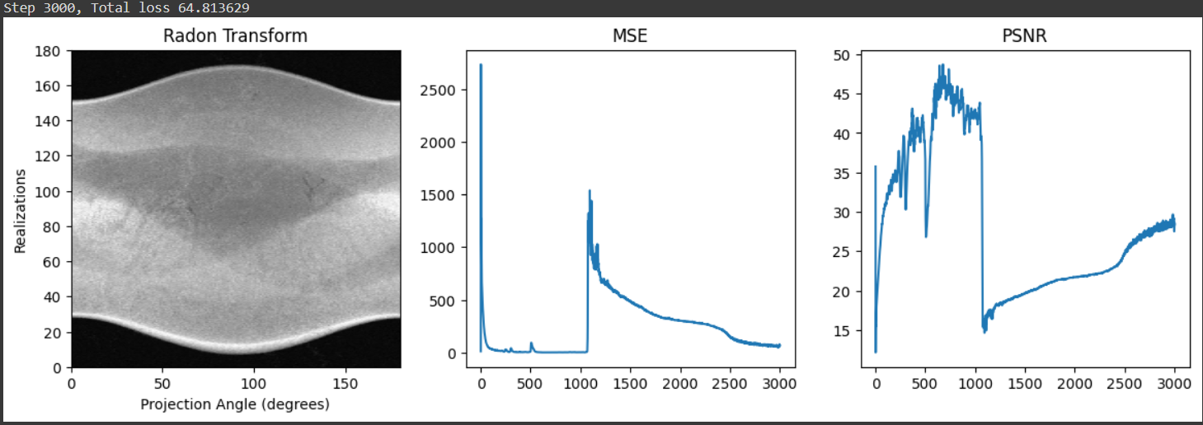
Adam : LR=1e-3

Slide 17
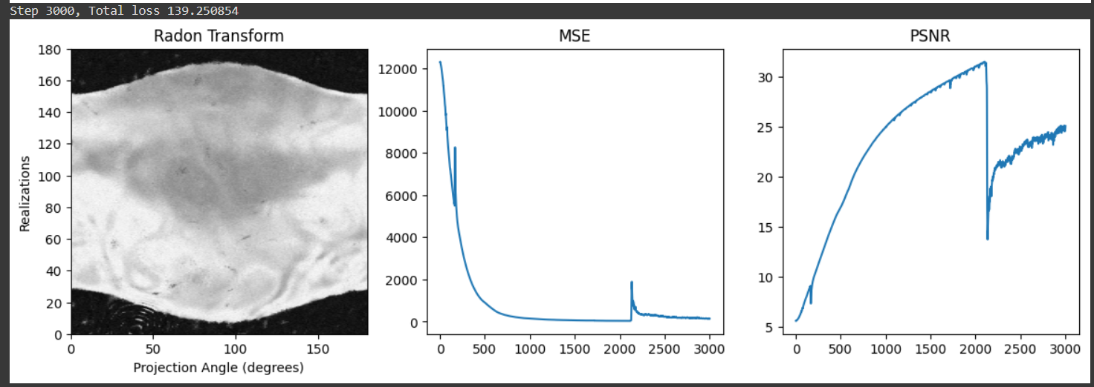
Adam : LR=1e-3

Slide 18
Experiment 3 - Image Denoising
Y
SIREN
X
Model output
Model input
Loss = MSE( Sinogram, Shepp-Logan Sinogram)
Sinogram

Slide 19
Results
Optimizer | LR | Steps | MSE | PSNR
Adam | 1e-4 | 1000 | 0.98 | 40.72
Adam | 1e-3 | 1000 | 0.89 | 41.12
Adam | 1e-3 | 1000 | 0.41 | 44.47
Adagrad | 1e-3 | 1000 | 10.90 | 30.25
(Test 1)
(Test 2)

Slide 20
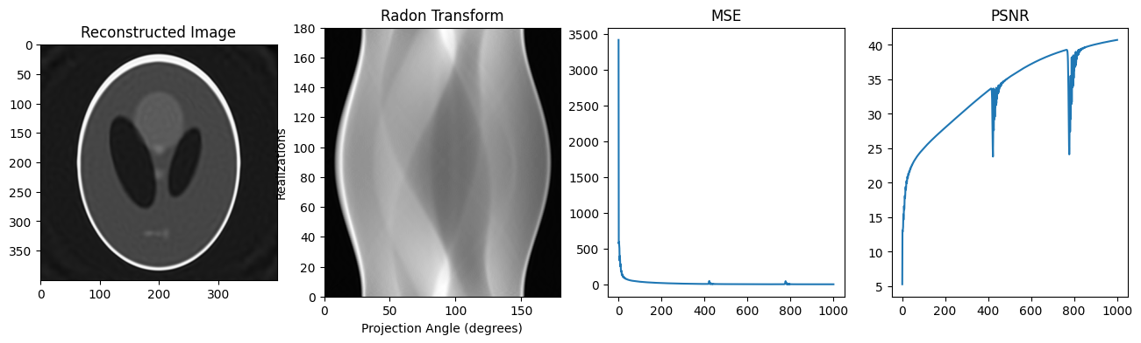
Adam : LR=1e-4 (1000 steps)

Slide 21
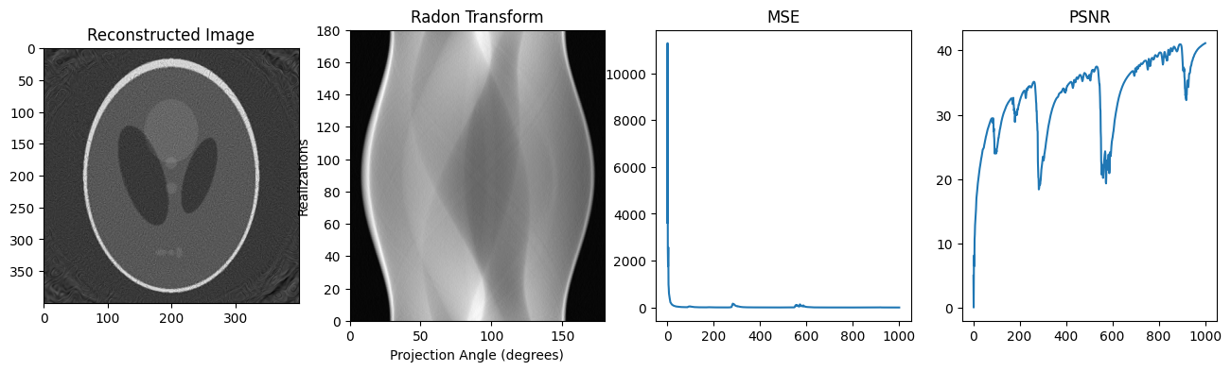
Adam : LR=1e-3 (1000 steps) (Test 1)

Slide 22
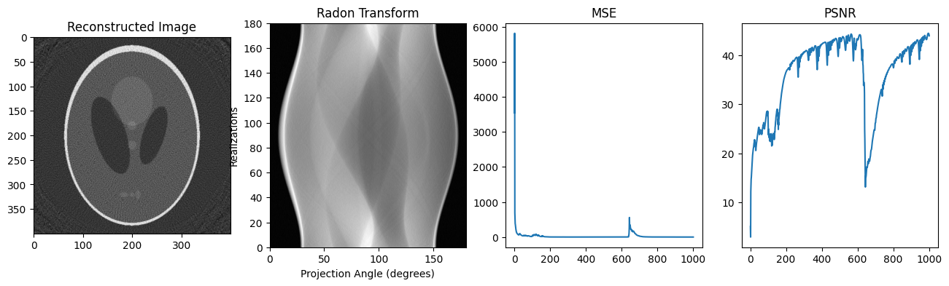
Adam : LR=1e-3 (1000 steps) (Test 2)

Slide 23
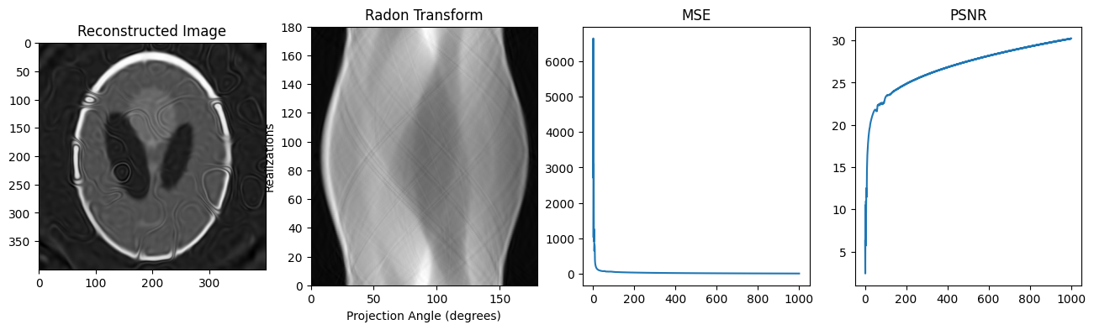
Adagrad : LR=1e-3 (1000 steps)

